Slide 1
NIL Analysis

Slide 2
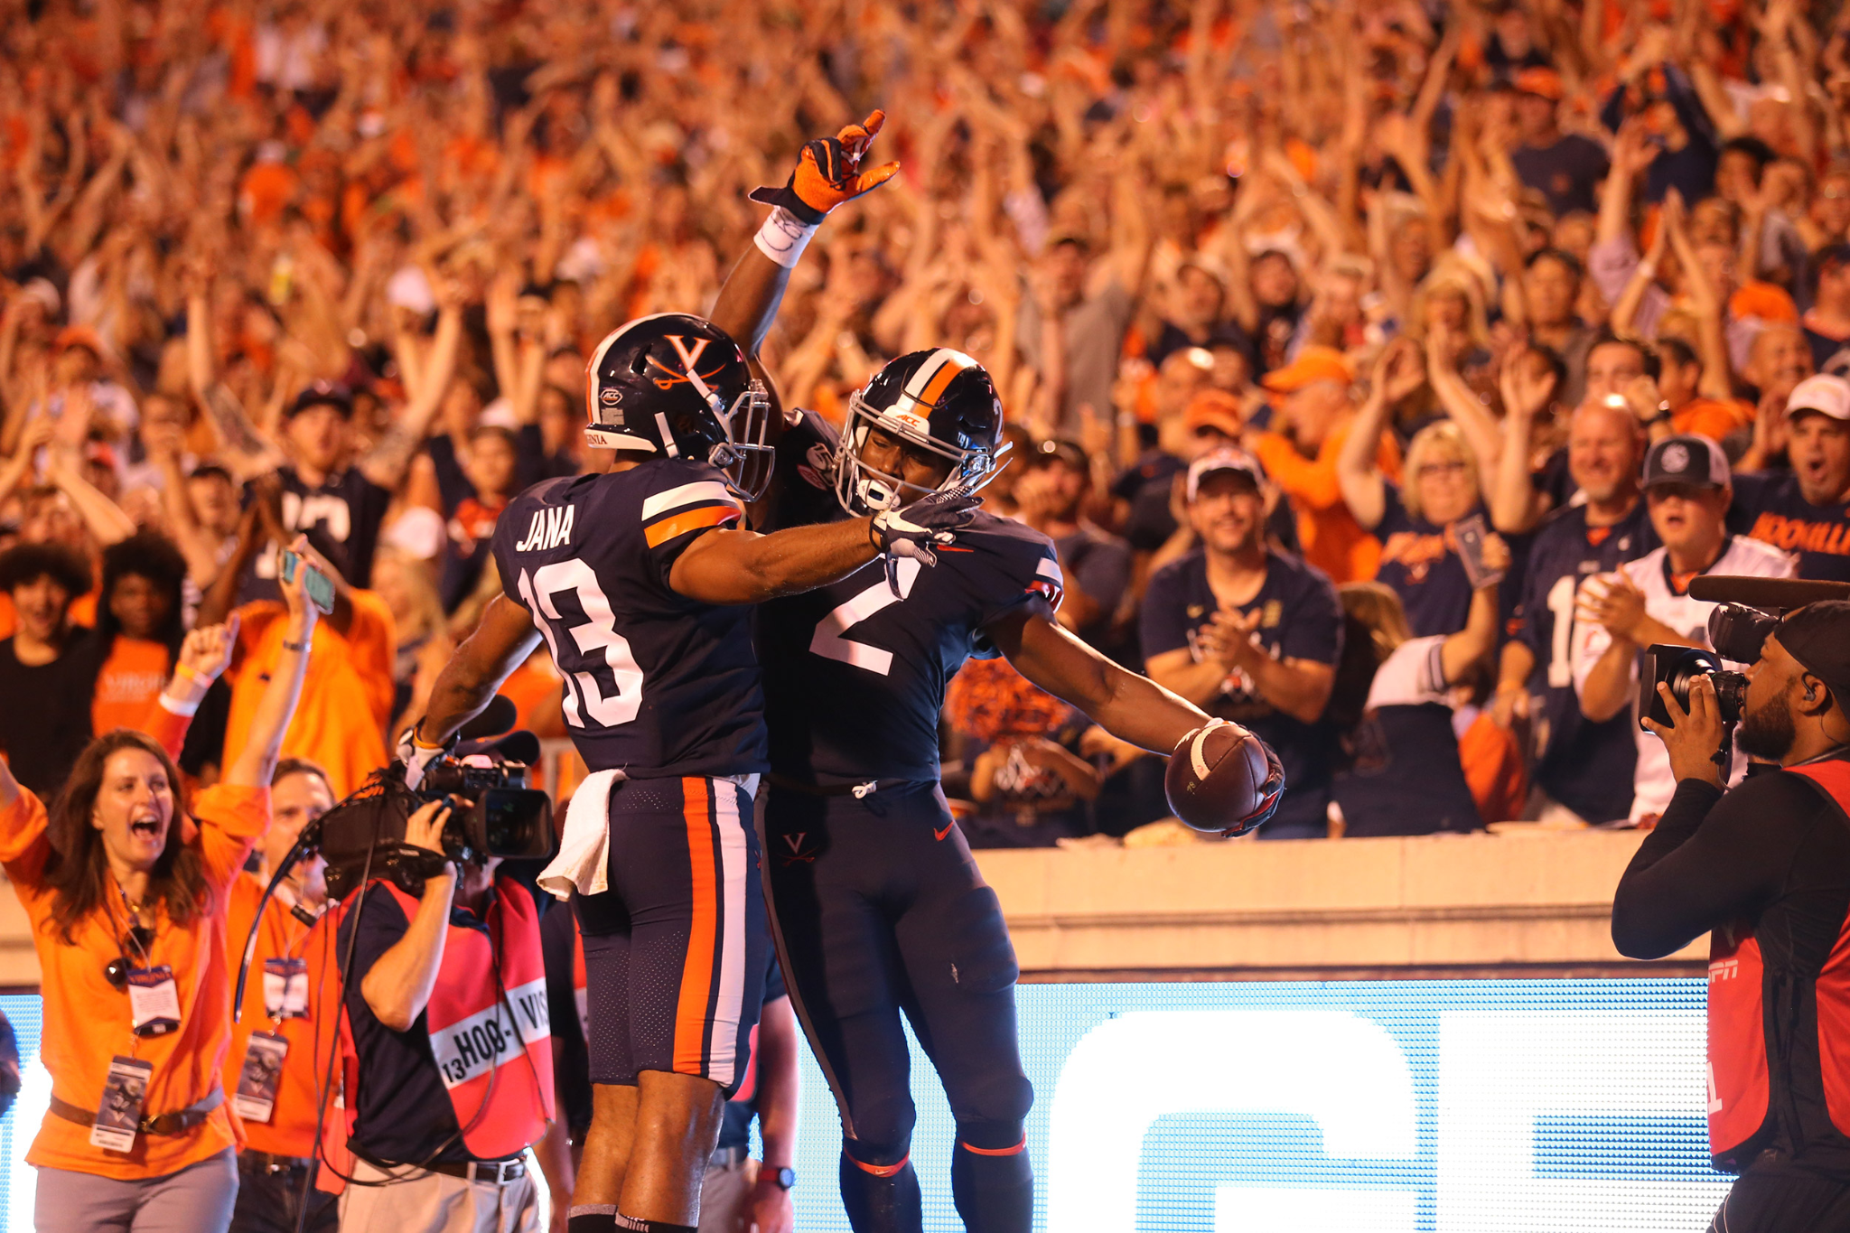
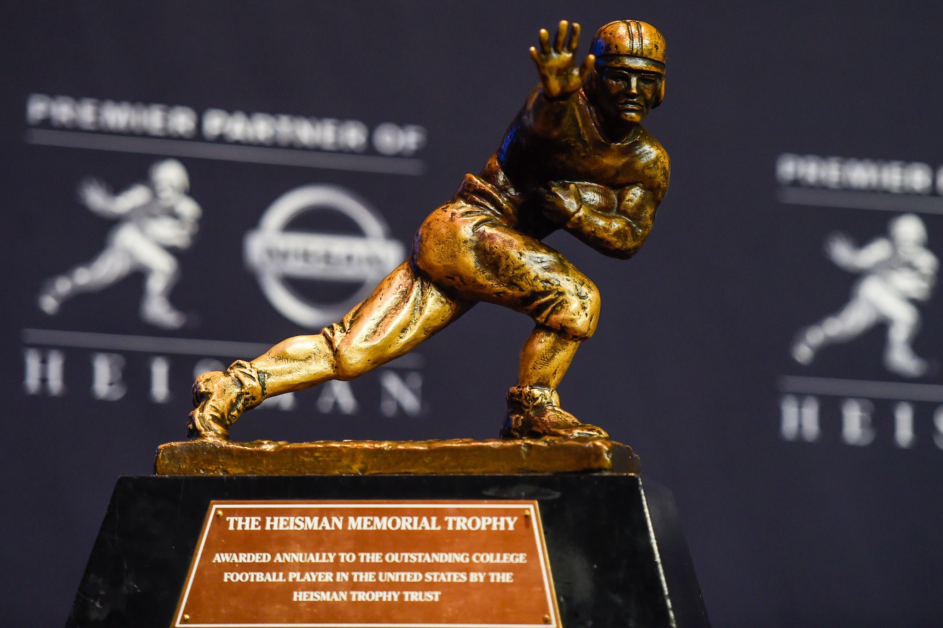
Introduction
Project Topic
NCAA Football Statistics From 2013-2023
Our project focused on college football data surrounding the expenses and revenue that football brought to the individual universities. Along with that data, the project further evaluated how these parameters can contribute to a teams success on the field.
Relevance
Recent NIL Developments
Recently the NCAA published new policy relating to NIL transactions which changes the way money is spent and used in college sports. This project can lend insight into spending effects in college football and any statistical benefit to increased spending
Goal
Predictive Modeling
The models that we have developed as a group for the project help to identify controllable variables that can contribute to both a football teams recruiting and in game performance. Overall the goal is to use the data we’ve collected and to assess true effect of spending practices in college football.

Slide 3
Research Question
Main Research Question: Does higher spending on college football programs correlate with increased success in terms of performance metrics?
How does the allocation of spending across different areas relate to team success?
What spending, if any, has an impact on FPI for the power 5 schools?
How has the relationship between spending and team success evolved over time within college football?

Slide 4


Data Collection
Data Sources:
Knight Newhouse College Athletics Database
Tracks college athletic and academic finances to provide greater transparency
and to better explain where the money comes from and where the money goes.
ESPN
Leading sports entertainment app/network that is highly regarded for being the leading
destination for all sports fans.
Variables Collected:
College Expenses/Revenues (Knight Newhouse):
Recruiting costs, coaches compensation/salaries, athletic aid, total revenue,
donor contributions, total football spending, etc
Football Performance Indicators:
Overall win/loss record, conference win/loss, recruitment rank, FPI (Football Power Index),
FPI ranking, and offensive/defensive efficiency.

Slide 5
Data Collection
Challenges:
Data Scraping:
Data scraping from ESPN required a wide array of web scraping techniques
to handle potential changes in website structure.
Data Cleaning:
Scraped data had many missing values which required further data cleaning.
Relevant in ESPN data for variable such as FPI, rank, and recruitment ranks.
Data Joining:
When joining the scraped data with the original CSV file, we had to individually
match IPEDS ID for each school
Could not match on name because there were different variations
between datasets.

Slide 6
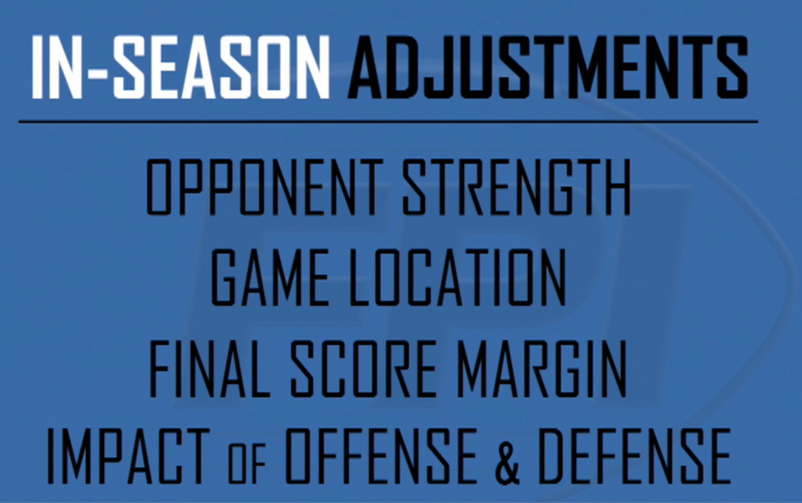
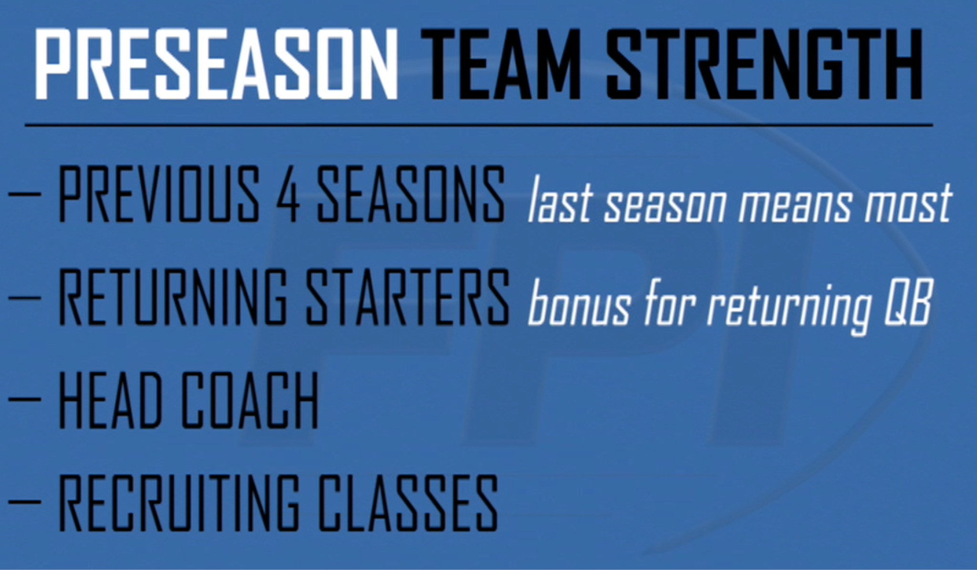
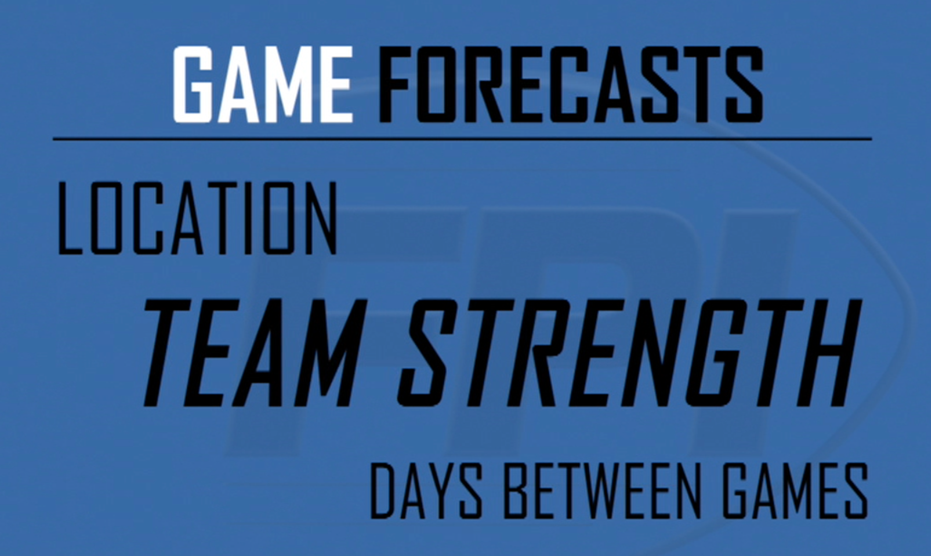
Football Performance Index
Notes:
During the beginning exploratory stage of the analysis, the FPI variable was deemed to be a good initial response variable for the data because it is a measure of team strength that is meant to be the best predictor of a team's performance for a season. FPI represents how many points above or below average a team is. The range of the FPI variable is -18.9 to 35.9 in this dataset. 0 is considered an average team.
EXPLAIN WHY FPI IS A GOOD PREDICT
RANGE - WHAT IS IT

Slide 7
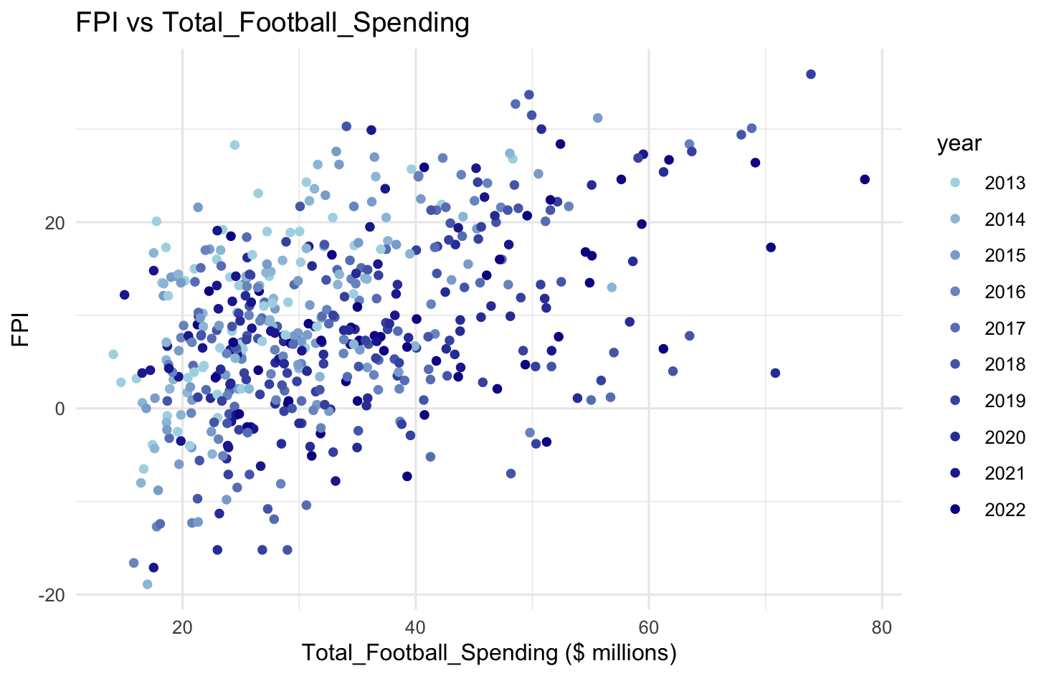
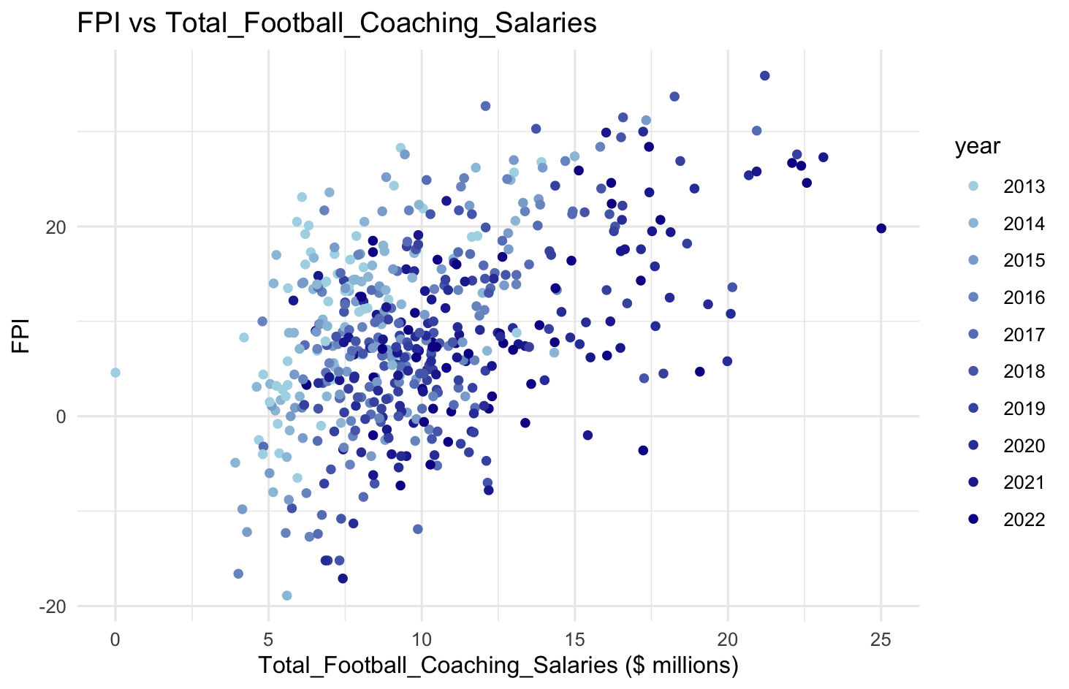
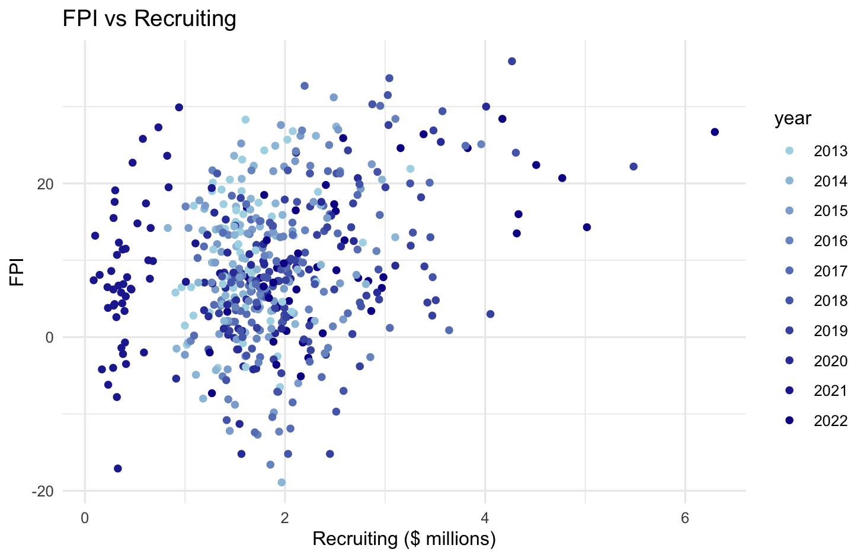
Exploratory Data Analysis
FPI vs Total Football Spending
FPI vs Total Football Salaries
FPI vs Recruiting Spending
FPI
Notes:
Linearity Assumption here\
Explain why FPI is a good response variable

Slide 8
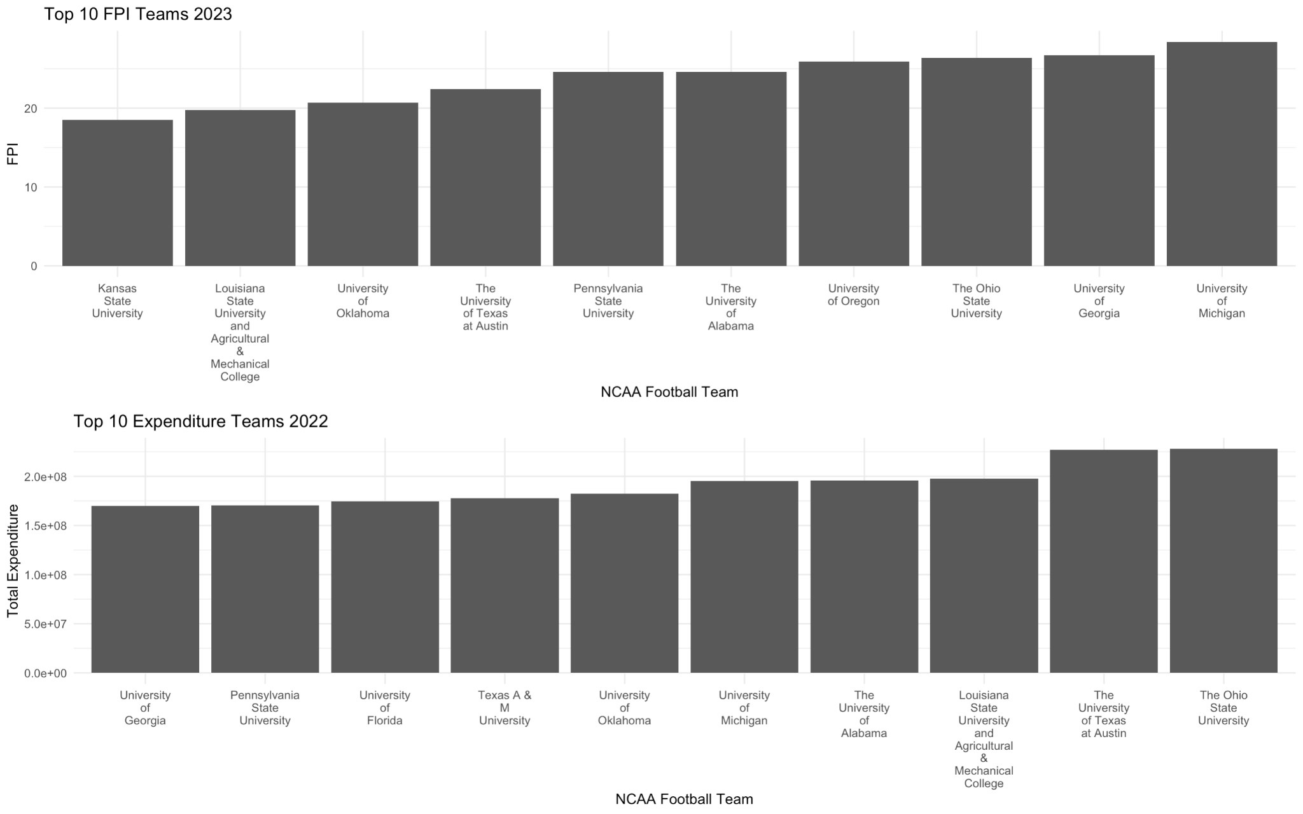
Top ten teams with highest FPI 2023
Top ten team with greatest total expenditures 2022

Slide 9
Analysis Plan
5. Final Model Evaluation and Refinement
Use rational and analytical skills to select significance predictors for the final general model to predict any universities FPI at any given year. Iterating on the analysis process as needed, refining models and interpretations based on outcomes and insights gained.
01
1. Initial Regression Analysis
Conduct yearly stepwise multiple linear regression (MLR) for monetary variables and baseline FPI from previous year versus the following year’s FPI.
05
02
2. Identify Issues
Assess multicollinearity among predictor variables, considering its impact on the inability to answer the research question.
4. Year-Wise Analysis Predictor Selection
Investigate all significant predictors of ten LASSO model and determine the most significant predictors, the magnitude of their coefficients, and goodness of fit measures
04
03
3. Refine LASSO Analysis Approach
Adapt the analysis by performing yearly LASSO models utilizing the same stepwise regression setup now with variable selections and mitigating multicollinearity
Notes:
Jill

Slide 10
Part 1 - Initial Regression Analysis
Previous years FPI as a “baseline measure of FPI”
Meet independent error assumption by reformatting the data into wide format
10 yearly stepwise regressions with 52 universities as observations
10 yearly stepwise regression with 52 universities s observations
Response: Future year’s FPI
Predictors: Previous year’s FPI & monetary predictor
Notes:
Jill
After manipulating the data, the modeling process started with a stepwise multiple linear regression for each individual year, spanning from 2014 to 2023 FPI. The yearly FPI was used as a response variable with numerous predictors including all other expense and revenue variables (omitting NA values) and the previous year’s FPI as a “baseline measure of FPI” for the 52 universities. This stepwise regression served to establish an initial relationship between FPI and the significant predictors of the dataset.
Predicting 2020 FPI(adjusted R-squared: 0.6581)
Total Expenses
Medical
Total Football coaching Salaries
Predicting 2021 FPI (adjusted R-squared: 0.6731)
Total Expenses
Coaches Compensation
Competition Guarantees earned
Institutional Government Support
Total Football Spending
Predicting 2022 FPI (adjusted R-squared: 0.6636)
Recruiting
Coaches compensations
Competition Guarantees earned
Institutional Government Support
Predicting 2023 FPI (adjusted R-squared: 0.7527)
Total Revenues
Corporate Sponsorship and advertising licensing
Donor contributions
NCAA Conference Distributions Media_Rights and Post-Season Football

Slide 11
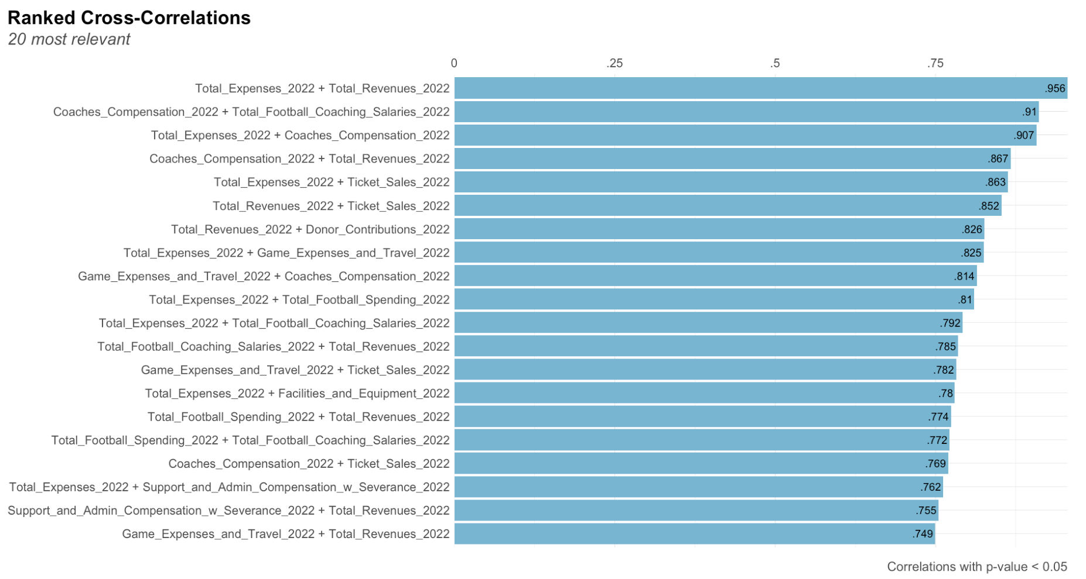
Part 2 - identify Issues: 2022 Example
Notes:
JIll

Slide 12
Part 3 - LASSO Approach
Least Absolute Shrinkage and Selection Operator (LASSO)
Variable Selection and Sparse Models
Narrow down the most relevant predictors while shrinking all other coefficients to 0 → maintains an interpretable model
Multicollinearity Issue
Directly penalizing the absolute size of coefficients.
Shrinks some coefficients to 0 → no effect in the model
Penalty Term
Balances the model complexity and goodness of fit → more stable and interpretable models.
Optimal Lambda and Cross Validation
Selects an optimal lambda through cross-validation that transforms data to minimize MSE
Goal: small number of variables with non-zero coefficients in order to identify the most important predictors and avoid multicollinearity
Notes:
The yearly data was then fitted with the optimal lambda and the RMSE was calculated. This was repeated for each year from 2014 to 2023.
LASSO regression can lose some information when variables are correlated because it retains only one of the variables and sets other correlated variables to zero. The interpretability of a LASSO regression is considered good when it selects a small number of features with non-zero coefficients, making it easier to identify the most important predictors
JIll

Slide 13
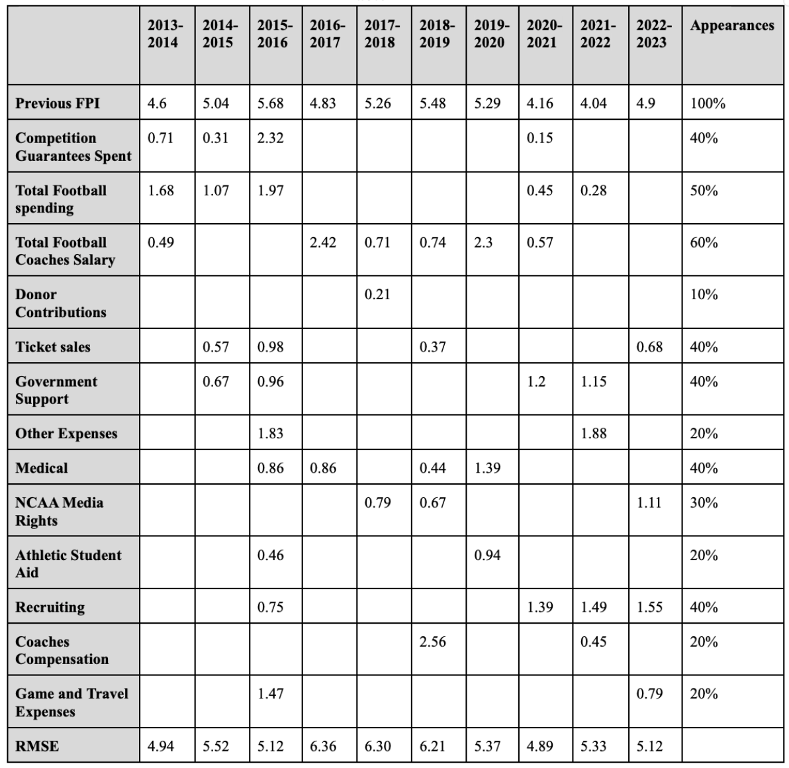
Part 4 - Year-wise Analysis Predictor selection
Notes:
the number of predictors dropped from twenty-one to anywhere between three and ten predictors.
Jill

Slide 14
Part 5 - Final Model Evaluation and Refinement
Iterative Selection (YoY chart)
All significant predictors
Significant predictors where model MSE < 30
Significant predictors that were significant in two or more models
Fine tuning
Adding and dropping variables based on frequency in other models
Goal to get MSE as low as possible
Notes:
Predicting 2020 FPI(adjusted R-squared: 0.6581)
Total Expenses
Medical
Total Football coaching Salaries
Predicting 2021 FPI (adjusted R-squared: 0.6731)
Total Expenses
Coaches Compensation
Competition Guarantees earned
Institutional Government Support
Total Football Spending
Predicting 2022 FPI (adjusted R-squared: 0.6636)
Recruiting
Coaches compensations
Competition Guarantees earned
Institutional Government Support
Predicting 2023 FPI (adjusted R-squared: 0.7527)
Total Revenues
Corporate Sponsorship and advertising licensing
Donor contributions
NCAA Conference Distributions Media_Rights and Post-Season Football

Slide 15
Results in the Process
Final Model Predictors:
FPI
Donor Contributions
Donations provided by individuals, corporations, associations, foundations, clubs, or other external organizations surpassing the nominal ticket price for athletics events.
Recruiting Expenses
Spending on transportation, lodging, meals, and other personnel and administrative expenses relating to recruitment of prospective student-athletes
Other Expenses
Costs of scholarships for athletes, purchase of gear, uniforms, and supplies, fundraising efforts, marketing/promotional activities, sports camps, support for spirit groups, membership fees, student-athlete meals, banquets and ceremonies, various operation expenditures.
Ticket Sales
Revenue received from ticket sales for all NCAA-sponsored sports at an institution
Final MSE: 38.35
Final RMSE: 6.19
Notes:
Predicting 2020 FPI(adjusted R-squared: 0.6581)
Total Expenses
Medical
Total Football coaching Salaries
Predicting 2021 FPI (adjusted R-squared: 0.6731)
Total Expenses
Coaches Compensation
Competition Guarantees earned
Institutional Government Support
Total Football Spending
Predicting 2022 FPI (adjusted R-squared: 0.6636)
Recruiting
Coaches compensations
Competition Guarantees earned
Institutional Government Support
Predicting 2023 FPI (adjusted R-squared: 0.7527)
Total Revenues
Corporate Sponsorship and advertising licensing
Donor contributions
NCAA Conference Distributions Media_Rights and Post-Season Football

Slide 16

Applied Example
Spending Analysis:
Despite a poor 2023 season record, UVA ranked 14th nationally in gross revenue, outperforming all ACC teams and several historically successful programs.
Suggests that expenditure allocation, rather than sheer spending amount, impacts performance.
UVA's average recruiting expenditure: $1.6 million per season.
Facility and equipment spending: $24 million per season.
Reallocation for Impact:
Proposal: Shift $2 million from facilities to recruiting.
Total recruiting cost: $3.6 million, double the average recruiting spending by Virginia.
Projected FPI improvement: from 4.7 to 11.8.
Strategic reallocation of finances can significantly improve the University of Virginia’s football program performance.
Notes:
Predicting 2020 FPI(adjusted R-squared: 0.6581)
Total Expenses
Medical
Total Football coaching Salaries
Predicting 2021 FPI (adjusted R-squared: 0.6731)
Total Expenses
Coaches Compensation
Competition Guarantees earned
Institutional Government Support
Total Football Spending
Predicting 2022 FPI (adjusted R-squared: 0.6636)
Recruiting
Coaches compensations
Competition Guarantees earned
Institutional Government Support
Predicting 2023 FPI (adjusted R-squared: 0.7527)
Total Revenues
Corporate Sponsorship and advertising licensing
Donor contributions
NCAA Conference Distributions Media_Rights and Post-Season Football

Slide 17
Discussion
Prioritizing recruitment and donor contribution expenses
FPI remains challenging to predict accurately
Access to NIL data (spend/program strategy) not currently publicly available, could enhance predictive accuracy.
NIL impact on team performance remains uncertain
Success in college football extends beyond financial resources
Team legacy/reputation
Individual players/coaches/coordinators
Changes in conference dynamics
shifts in team strengths
strength of schedule measures
Notes:
Predicting 2020 FPI(adjusted R-squared: 0.6581)
Total Expenses
Medical
Total Football coaching Salaries
Predicting 2021 FPI (adjusted R-squared: 0.6731)
Total Expenses
Coaches Compensation
Competition Guarantees earned
Institutional Government Support
Total Football Spending
Predicting 2022 FPI (adjusted R-squared: 0.6636)
Recruiting
Coaches compensations
Competition Guarantees earned
Institutional Government Support
Predicting 2023 FPI (adjusted R-squared: 0.7527)
Total Revenues
Corporate Sponsorship and advertising licensing
Donor contributions
NCAA Conference Distributions Media_Rights and Post-Season Football

Slide 18
QUESTIONS?

